Slide 1
Analytical Data Report
HR Analysis Insight

Slide 2
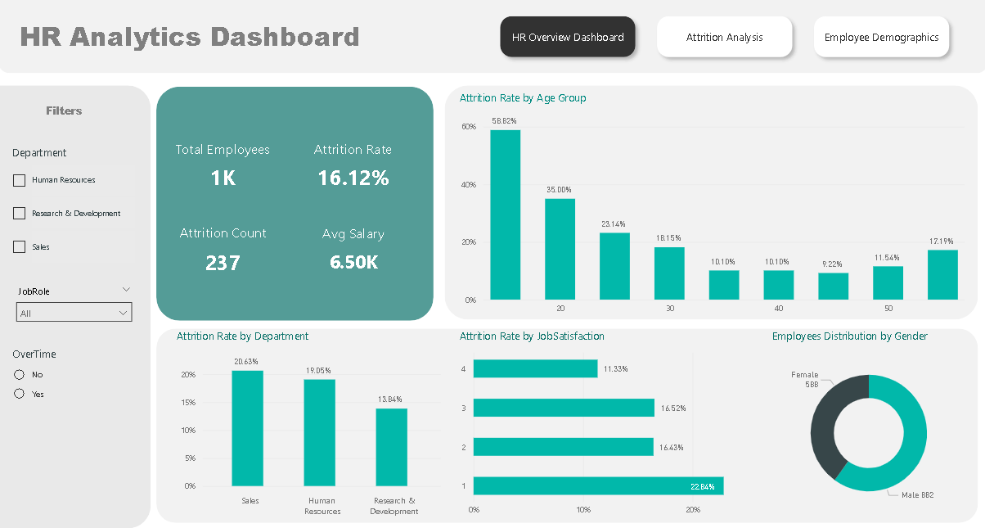
HR Overview Dashboard
1.Workforce Overview
The organization has a total workforce of approximately 1,000 employees, with an overall attrition rate of 16.12%, indicating moderate employee turnover. The average salary stands at 6.5K, while total attrition count reached 237 employees.
2. Age-based Attrition
Younger employees show significantly higher attrition rates, particularly employees in their early 20s. Attrition gradually declines with age, indicating retention challenges among early-career employees.
3.Department Attrition
The Sales department recorded the highest attrition rate, followed by Human Resources, while Research & Development had comparatively lower employee turnover.
4.Job Satisfaction
Employees with lower job satisfaction levels demonstrate higher attrition rates, indicating dissatisfaction as a key driver of employee turnover.

Slide 3
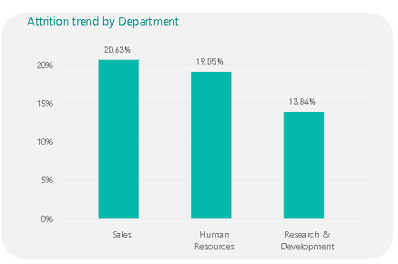
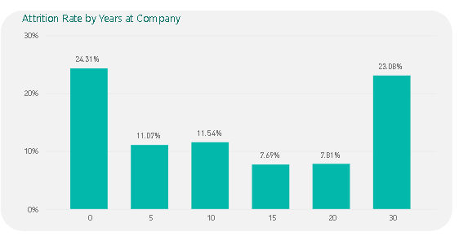
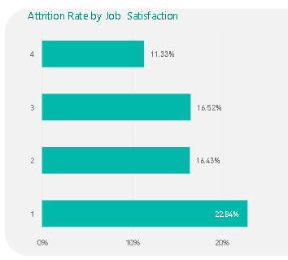
Attrition Analysis
1.Department-Wise Attrition
The Sales department recorded the highest attrition rate (20.63%), followed by Human Resources (19.05%), while Research & Development showed the lowest attrition rate (13.84%). This indicates that customer-facing and support roles may be experiencing higher turnover pressure.
2. Attrition by Years at Company
Employees with 0 years of tenure showed the highest attrition rate (24.31%), indicating that newly hired employees are leaving early. Attrition also rises again among employees with 30 years of tenure (23.08%), which may reflect retirement or late-career exits.
3. Job Satisfaction Impact
Employees with Job Satisfaction level 1 recorded the highest attrition rate at 22.84%, while employees with higher satisfaction levels showed lower attrition. This suggests employee satisfaction is strongly linked to retention.

Slide 4
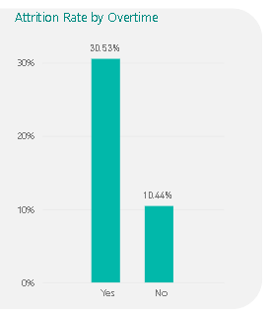
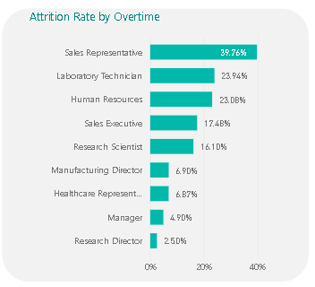
4. Overtime Impact
Employees working overtime experienced significantly higher attrition (30.53%) compared to employees not working overtime (10.44%). This indicates workload imbalance may be a major factor contributing to employee exits.
5. Job Role Attrition
Among all job roles, Sales Representatives (39.76%) faced the highest attrition, followed by Laboratory Technicians (23.74%) and Human Resources roles (23.08%). These roles may require targeted retention strategies.

Slide 5
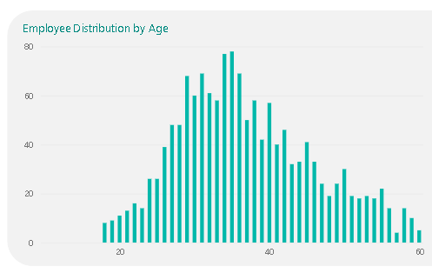
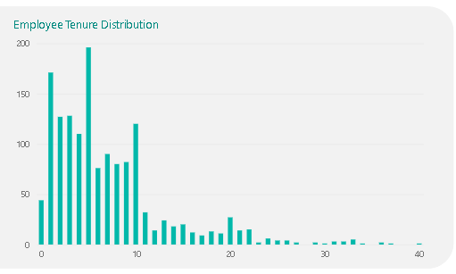
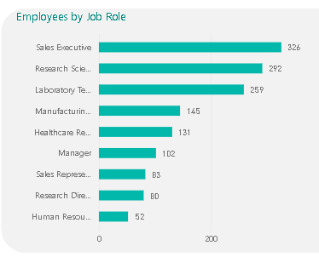
Employee Demographics Analysis
1.Age Distribution
The workforce is primarily concentrated between the age group of 25–40 years, with the highest employee concentration around the early-to-mid 30s. This indicates that the company largely consists of mid-career professionals.
2. Employee Tenure Distribution
A large portion of employees have tenure between 1–10 years, while significantly fewer employees stay beyond 20 years. This indicates that most employees are in the early-to-mid stages of their careers.
3. Job Role Distribution
Sales Executives (326 employees) represent the largest workforce segment, followed by Research Scientists (292 employees) and Laboratory Technicians (259 employees). This indicates the company heavily relies on sales and research-related roles.

Slide 6
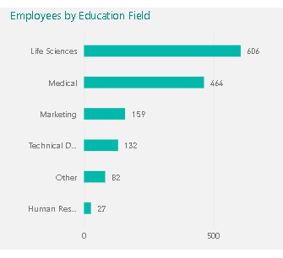
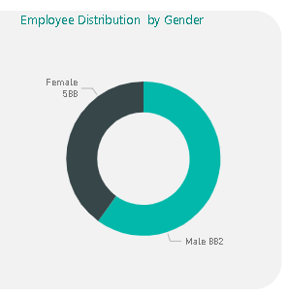
4. Education Field Distribution
Most employees come from Life Sciences (606 employees) and Medical backgrounds (464 employees), showing that the workforce is primarily built around healthcare/science-related expertise.
5. Gender Distribution
The organization has a relatively balanced gender workforce, with 882 male employees and 588 female employees, though male employees represent a larger share of the workforce.

